Slide 1

Introduction to Arduino
Speaker:
Sargun Walia
M.Eng, Information Security at UVic

Slide 2
Microcontrollers
Basically mini computers
In technical terms - A microcontroller is a computer present in a single integrated circuit which is used to perform one task and execute one specific application.
Often called Embedded Systems
Real Life Applications –
Robotics - Obstacle Avoiding Robot
Health Monitoring Systems – Health Monitoring over GPS

Slide 3
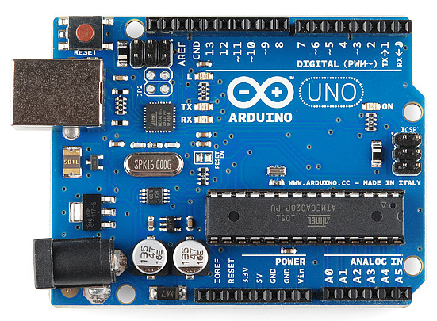
So.. What is ARDUINO?
Open-source electronics platform based on easy-to-use hardware and software
It consists of a microcontroller & a programmable IDE.

Slide 4
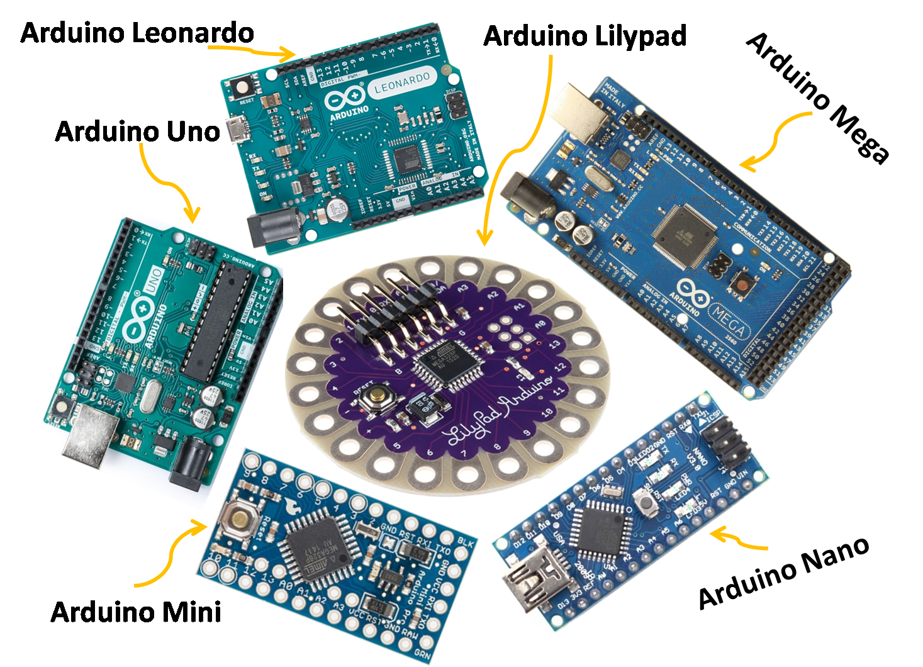
Types of Arduino Boards
Many different types of Arduino Boards based on the number of pins and different functionalities.

Slide 5
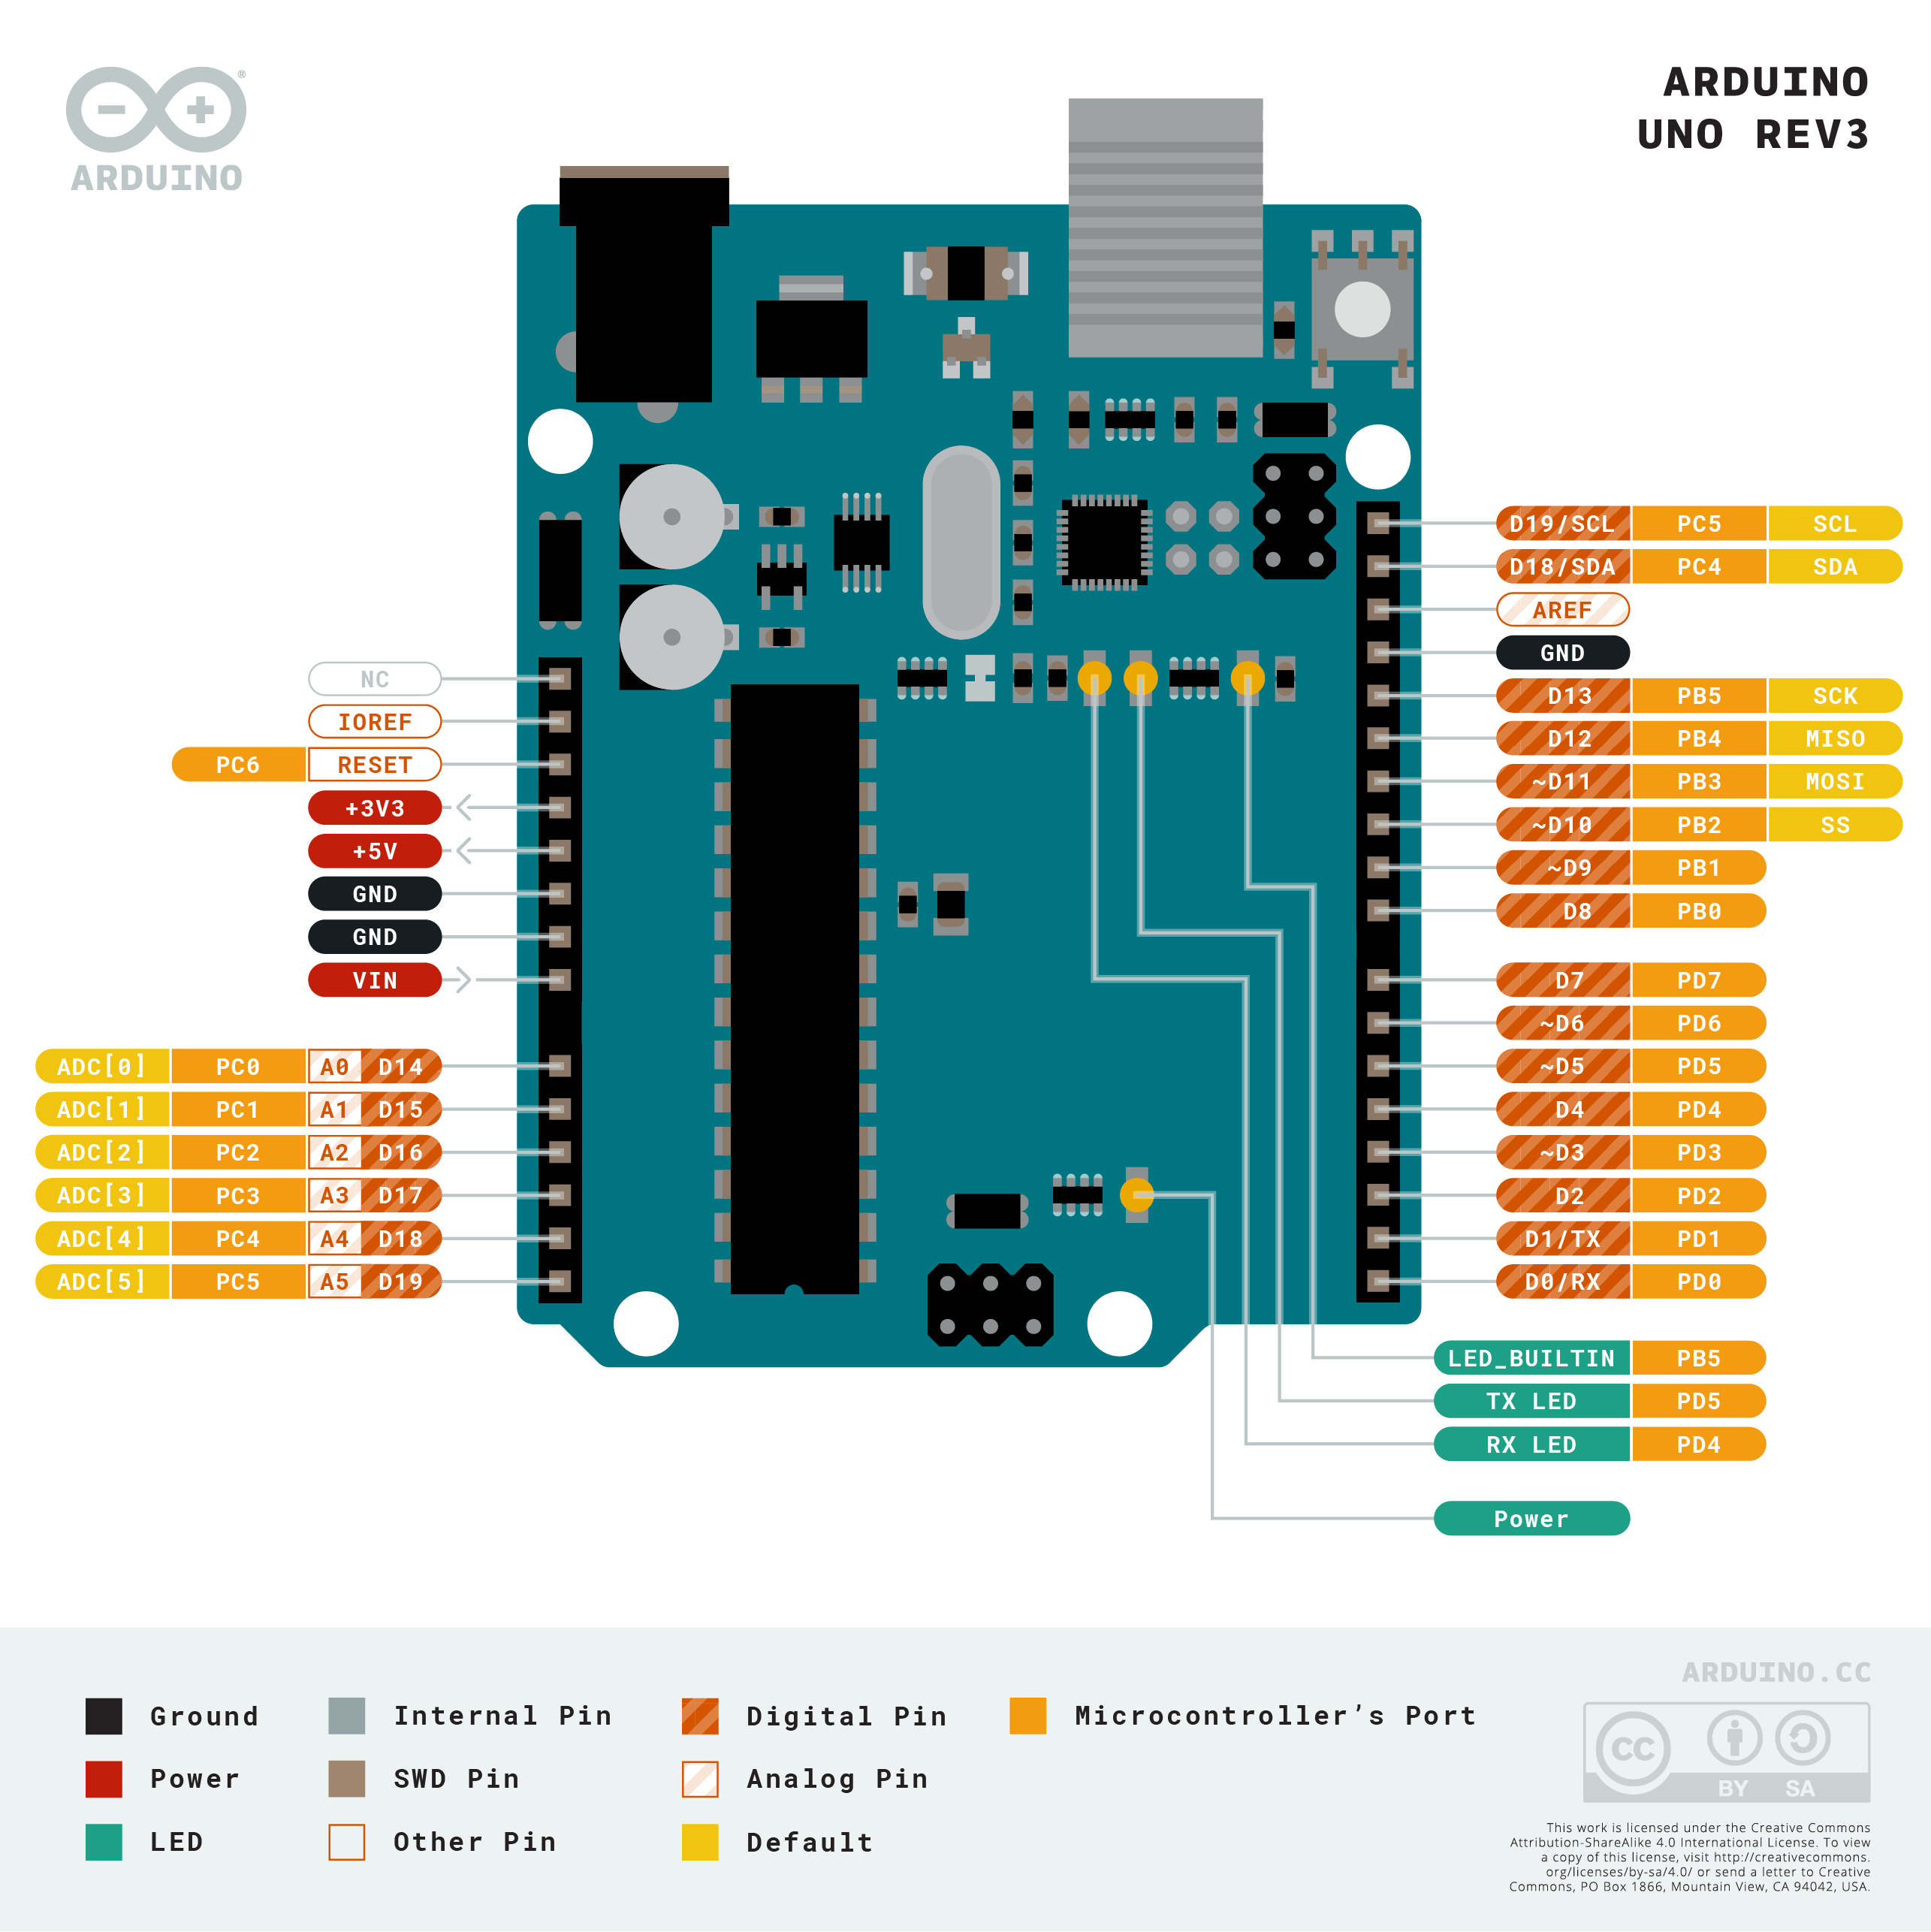
Let’s get to know Arduino a bit better..
14 Digital I/O Pins
6 Analog Input Pins
A USB Connection
Main IC
Reset Button

Slide 6
Why Arduino?
Cost – effective
Platform Friendly
Simple Programming Environment
Open Source

Slide 7
Programming in Arduino
Based on C/C++ Programming Languages.
The bare minimum code you need for an Arduino program
void setup()
{
// put your setup code here, to run once:
}
void loop()
{
// put your main code here, to run repeatedly:
}

Slide 8
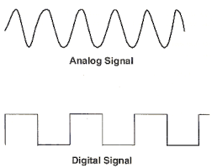
Digital & Analog Signals
ANALOG SIGNALS –
Continuous Time Varying signal
No fixed range
DIGITAL SIGNALS –
Discrete Time Varying Signal
Range is finite – 0 or 1, HIGH or LOW

Slide 9
Some Important Functions
Digital Signals
pinMode (pin_number, mode)
digitalWrite(pin_number,value)
digitalRead(pin_number)
Analog Signals
pinMode (pin_number, mode)
analogWrite(pin_number,val)
analogRead(pin_number)

Slide 10


Slide 11
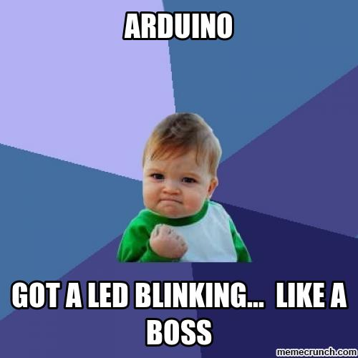

Slide 12
Activity for You
Design a Motion Detection Alarm System using PIR Motion Sensor

